Slide 1


Working with Qualitative Data
IL “Data and Decision Making” SS 26
Kami Höferl
(MervC, CC-BY-NC 2.0)

Slide 2
Overview
Is all Data just Numbers?
Recap: Qualitative Interviews & Data
Transcription of Audio- & Video Material
Qualitative Content Analysis Software
Thematic Coding
What about AI?
(MervC, CC-BY-NC 2.0)
(Escher, 1961)

Slide 3
But: Why Data Driven … Everything?
Not Everything: But management
“Management is a distinct process consisting of planning, organising, actuating, and controlling, performed to determine and accomplish stated objectives.” (Terry 1953)
“To manage is to forecast and plan, to organise, to command, to coordinate and to control.” (Fayol 1916)
👉 ideally: based on hard empiric evidence = data

Slide 4
But: Why Data Driven … Everything?
Reduces reliance on intuition, hierarchy or anecdote
Improves decision quality through systematic data analysis
Makes assumptions transparent & testable
Helps identify real drivers of performance and risk
Enables evaluation of strategic alternatives before committing resources
Supports learning from past decisions through measurable outcomes
Strengthens accountability towards stakeholders
Increases organisational credibility and legitimacy
Improves adaptability in dynamic and uncertain environments
Aligns strategy with measurable impact rather than opinion

Slide 5
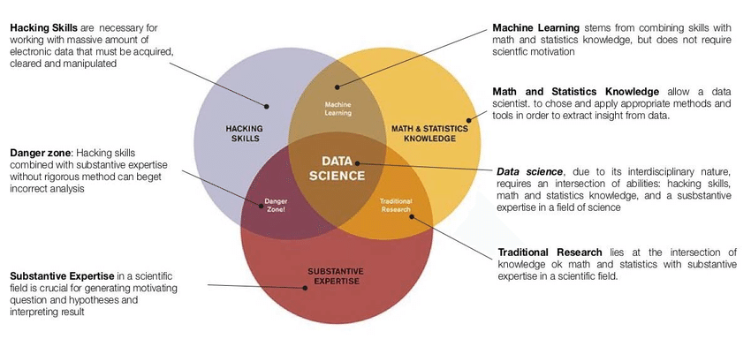
From Statistics to Data Science

Slide 6
An often Unspoken Assumption:
Data = Numbers (= structured data)
Sensor & IoT data: temperature, GPS coordinates, accelerometer readings
Text: emails, reports, social media posts, survey responses
Documents: contracts, research papers, forms
Images: photos, satellite imagery, medical scans, diagrams
Audio: voice recordings, music, podcasts, environmental sensors
Video: surveillance footage, lecture recordings, user-generated content
Graphs & networks: social connections, supply chains, knowledge graphs

Slide 7
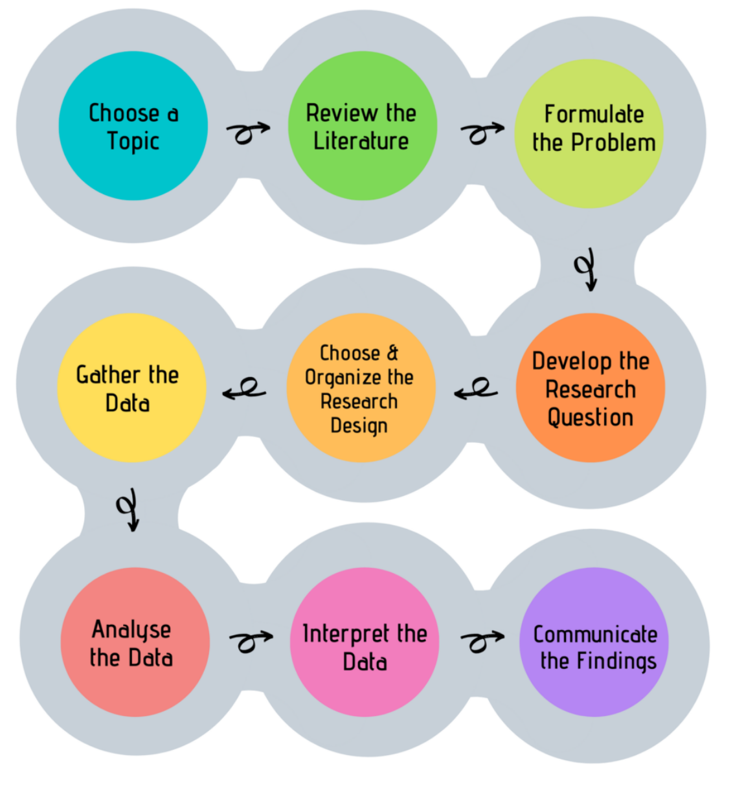
Look, Think, Test, Tell

Slide 8
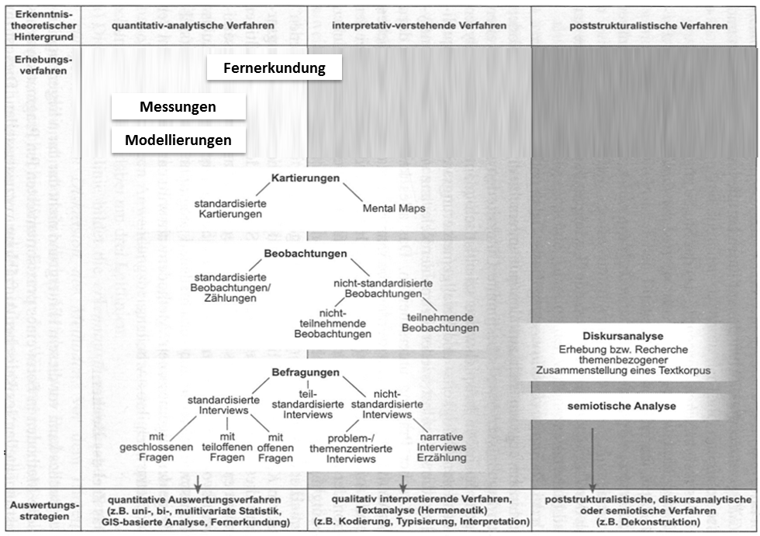
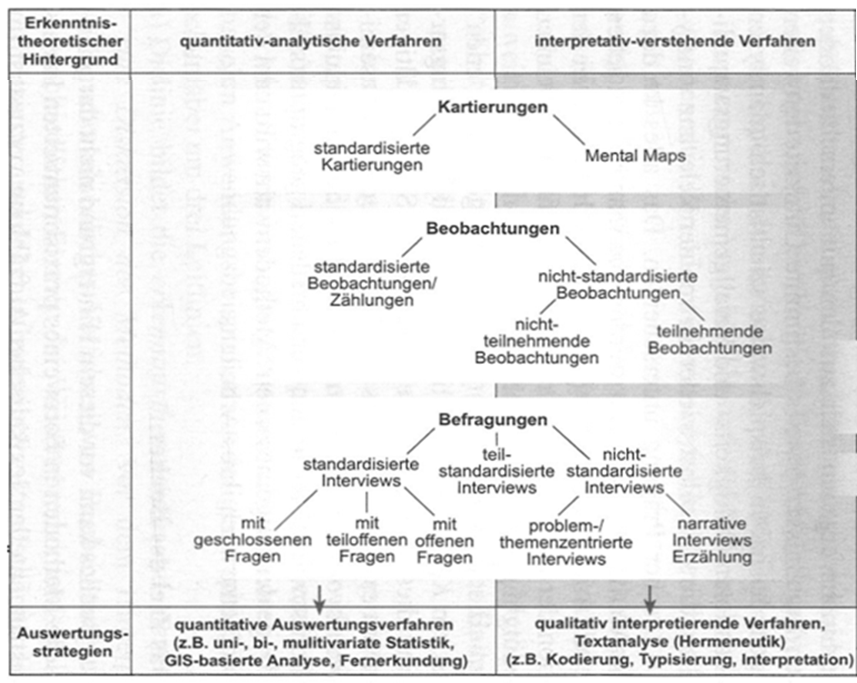
What Methods are There? An Overview

Slide 9

The qualitative Interview
Aim: "subjective view of actors about past events, future plans, opinions, health complaints, relationship problems, experiences in the world of work, etc.“ (Bortz & Döring 2009:308)
Based on open questions → Allows interviewees room for manoeuvre when answering
Takes into account interaction between interviewer and interviewee → follow-up questions etc.
Takes into account impressions & interpretations of the interviewer

Slide 10
Workflow
1. Content preparation
2. Organisational preparation
3. Start of conversation
„Interview“
4. Conducting the interview
5. End of conversation & farewell
6. Interview notes
7.Transcription
8. Content analysis

Slide 11
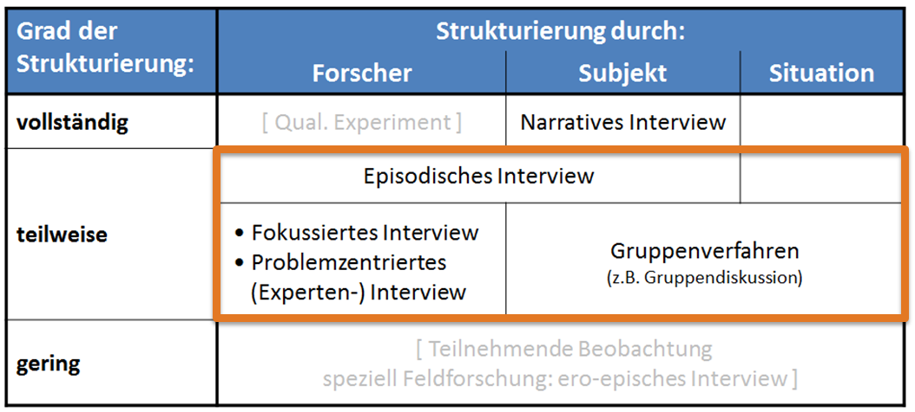
Types of qualitative Interviews

Slide 12

Digression: The Interview Guide
Partial standardisation
Content-related considerations on a topic area
👉 Useful if prior knowledge of the topic already exists & certain questions should be at the centre
Contents:
Topics to be addressed in a reasonable order
Possible formulation suggestions / key points
→ Order not necessarily specified, arises in the course of the conversation
→ Tick off questions so as not to forget anything

Slide 13
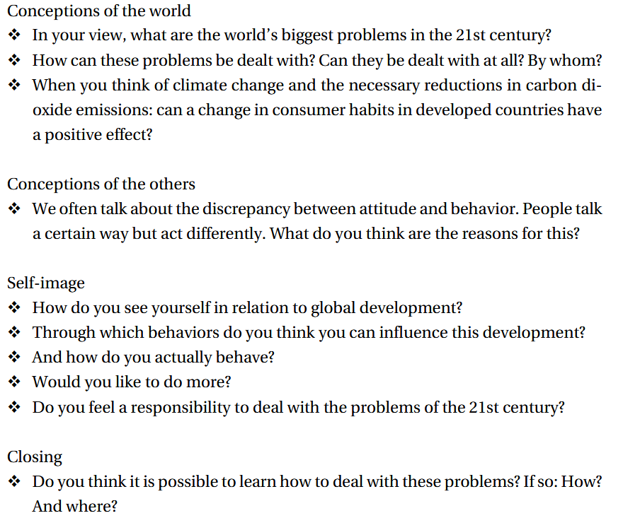
The Interview Guide
(Rädiker & Kuckartz, 2020: 42)

Slide 14
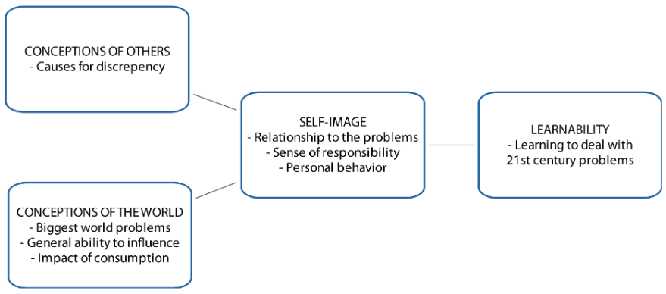
The Interview Guide – From Questions to Topics …

Slide 15
Workflow
1. Content preparation
2. Organisational preparation
3. Start of conversation
„Interview“
4. Conducting the interview
5. End of conversation & farewell
6. Interview notes
7.Transcription
8. Content analysis

Slide 16
Transcription

Slide 17
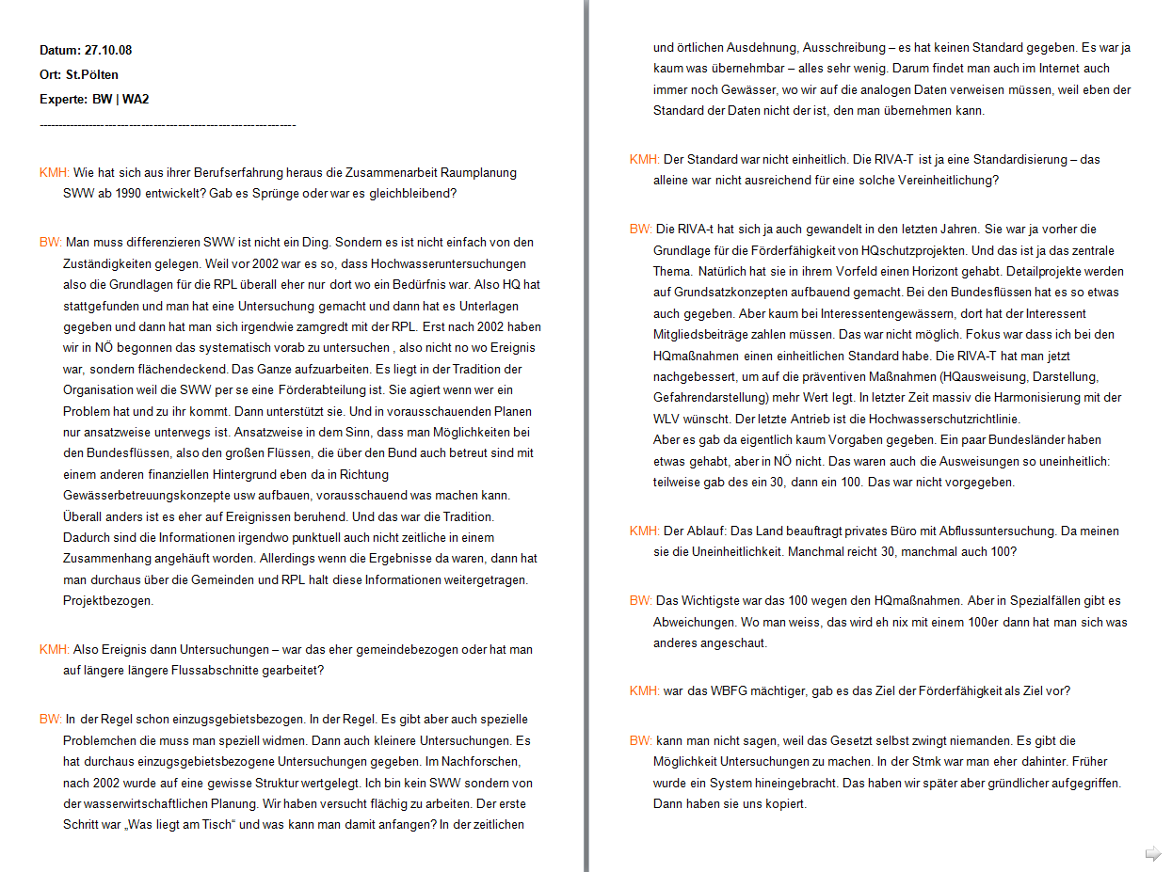
Transcription Old School Style
Mark speakers with capital letters
Blank lines for speaker changes
No "formatting bells and whistles"

Slide 18
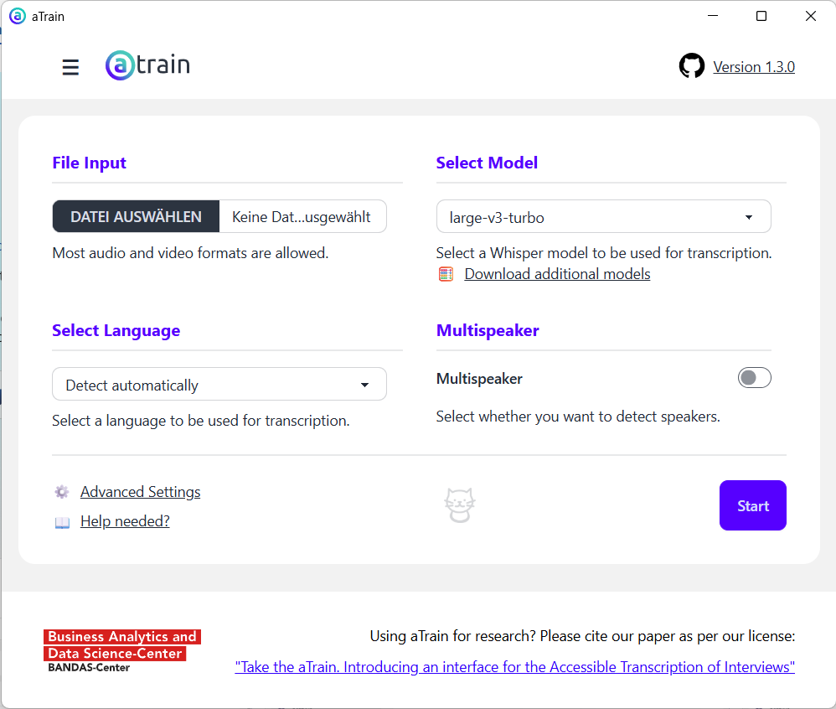
Transcription: Selber machen lassen 😉
Why local?
GDPR compliant
If with online services:
GDPR compliant
👉 especially: Rights of use

Slide 19

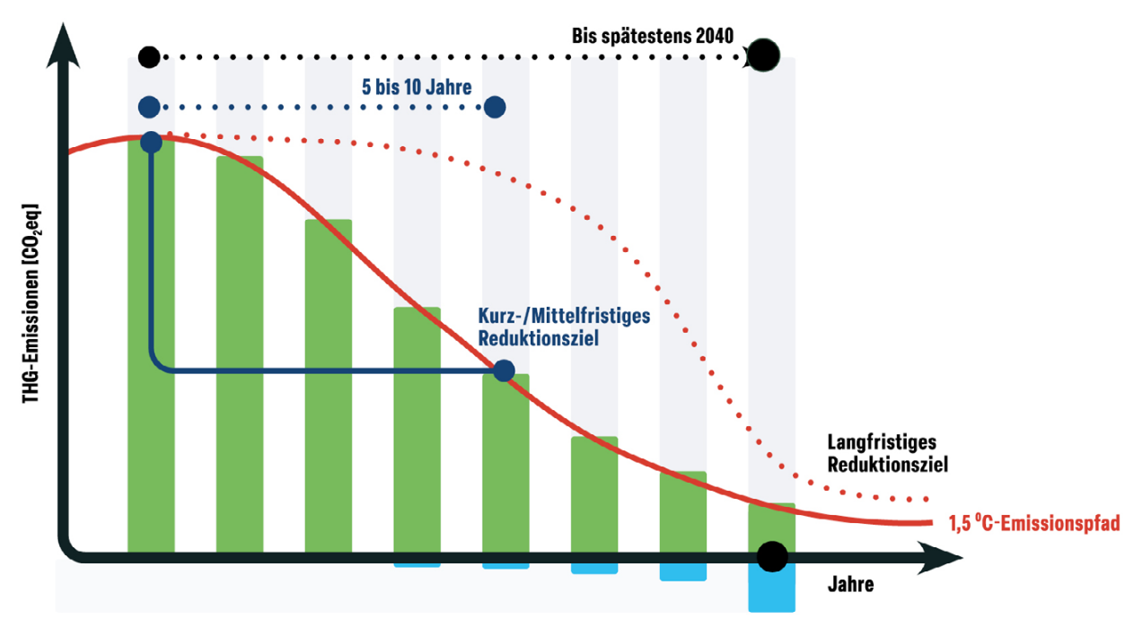
An Example:
How Austrian SMEs Approach Net-Zero: Meanings, Motivations, Barriers, and Futures

Slide 20
Digression: The Interview Guide
Partial standardisation
Content-related considerations on a topic area
👉 Useful if prior knowledge of the topic already exists & certain questions should be at the centre
Contents:
Topics to be addressed in a reasonable order
Possible formulation suggestions / key points
→ Order not necessarily specified, arises in the course of the conversation
→ Tick off questions so as not to forget anything

Slide 21
How Austrian SMEs Approach Net-Zero: Meanings, Motivations, Barriers, and Futures
RQ1 – Understanding of Net-Zero: How do SME managers define net-zero in the context of their own company, and what distinctions do they draw?
RQ2 – Barriers: What obstacles do SME managers perceive as most significant when implementing net-zero strategies in their operations?
RQ3 – Motivation: How do SME managers frame their motivation for pursuing net-zero strategies?
RQ4 – Future Outlook: What vision do SME managers have for their company’s net-zero efforts, and how concrete and time-bound is it?

Slide 22
Qualitative Content Analysis Software

Slide 23
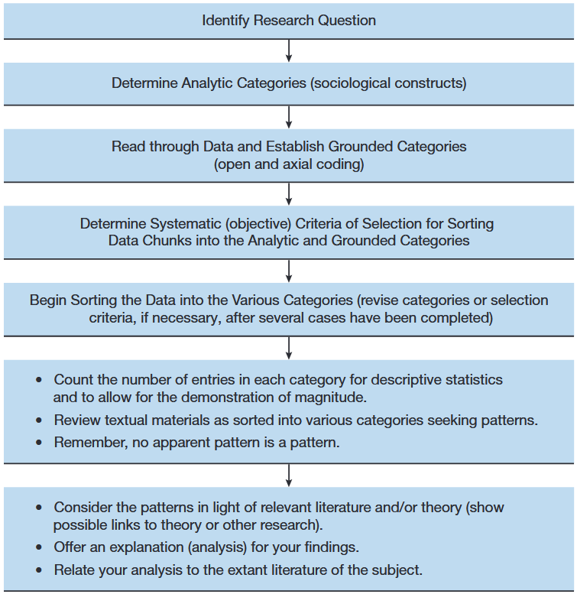
Qualitative Content Analysis in a Nutshell
A) Qualitative content analysis:
Systematic method to analyse and interpret communication content.
texts, images, or media
Identifies patterns, themes, or meanings
Involves coding and categorising data

Slide 24
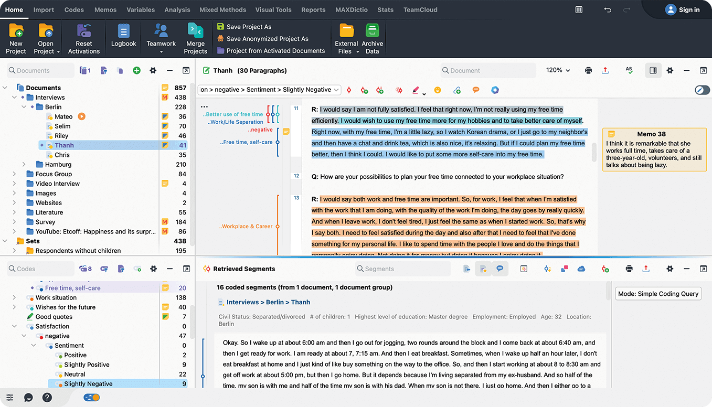
An Example: MAXQDA

Slide 25

An Example: MAXQDA

Slide 26


An Example: MAXQDA

Slide 27
Thematic coding a la Hopf et al. (1995)

Slide 28
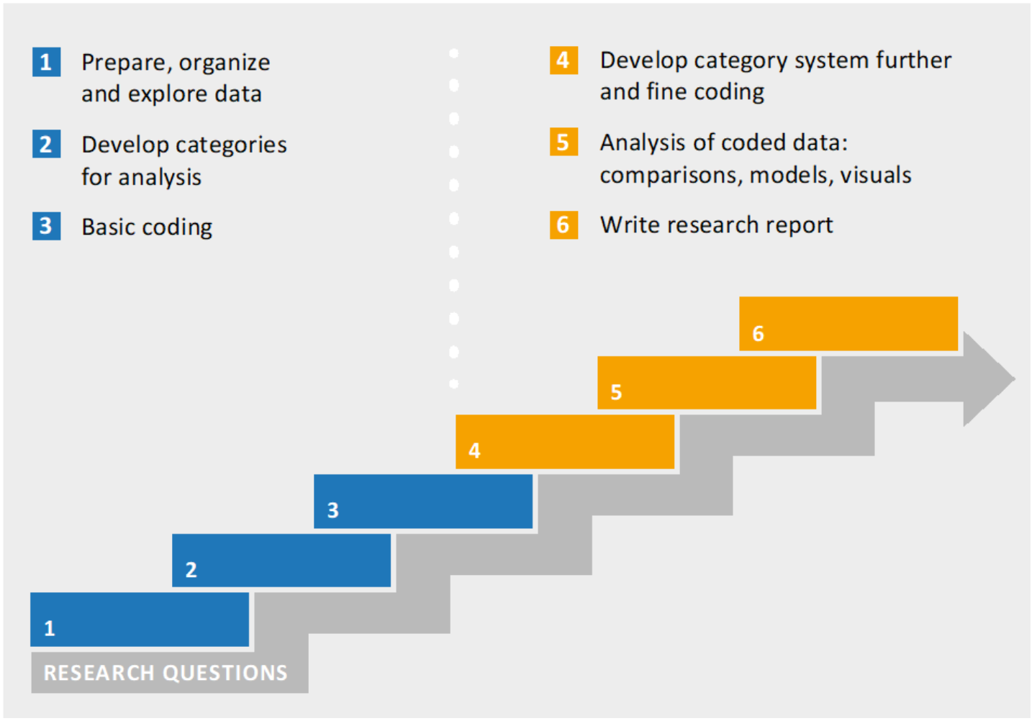
Qualitative Analysis: The Basic Workflow

Slide 29
One Approach: Thematic Coding (cf. Hopf et al 1995):
Development of evaluation categories
Coding the material
Quant. material overview
Optional: In-depth interpretation of individual cases

Slide 30

The Interview Guide
(Rädiker & Kuckartz, 2020: 42)

Slide 31
The Interview Guide – From Questions to Topics …

Slide 32
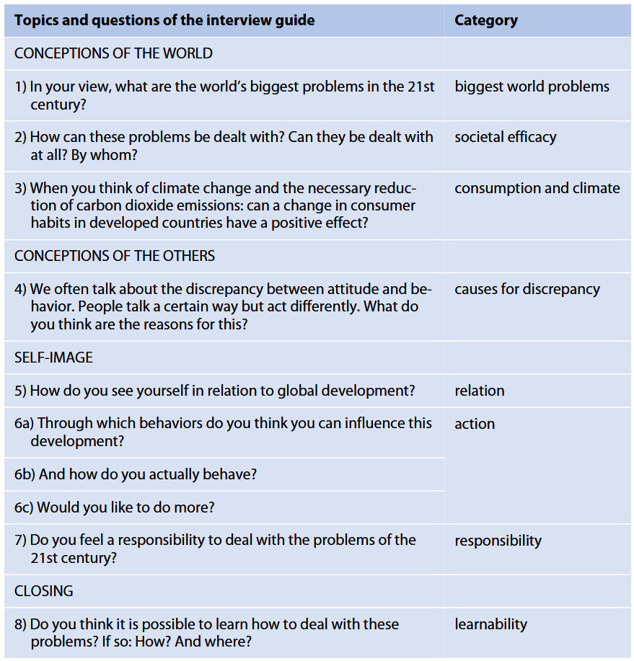
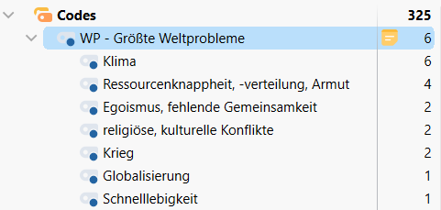
The Interview Guide – From Topics to Categories

Slide 33
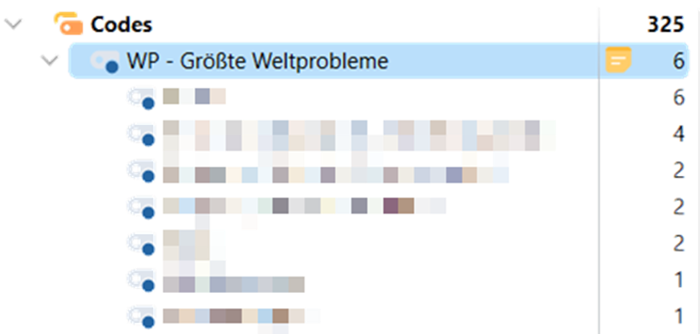
The Interview Guide – From Categories to (Sub-)Codes

Slide 34
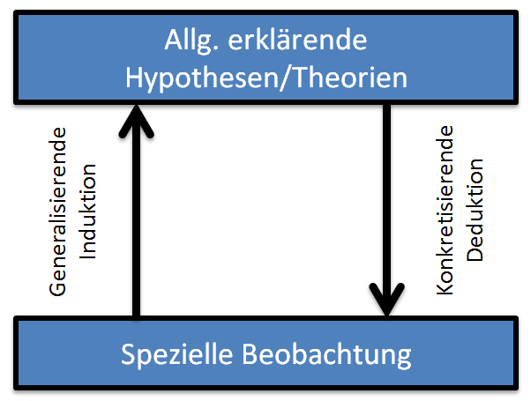
One Approach: Thematic Coding (cf. Hopf et al 1995):
Development of evaluation categories:
Theory-based "drafts": parallel to the development of interview guidelines
E.g. attitude towards citizen participation
Deductive approach: theory-based inference of category system 👉 specification leads to categories
Inductive approach: from the examination of the research corpus 👉 categories 👉 abstraction leads to summarised units of meaning
Often: Combination of a & b 👉 cf. “Abductive Reasoning”

Slide 35
One Approach: Thematic Coding (cf. Hopf et al 1995):
Creating a coding guide
Nr. | Category | Definition | Manifestations | Examples | Coding rules
1 | Biggest world problem | This category is used when current world problems are named, explained, or related to each other. Included are the respondents’ own positions and evaluations of the world problems. | Climate Resource scarcity Globalisation Other | … | All climate related stuff (CO2, Sea level rise etc.) falls under „Climate“ …

Slide 36
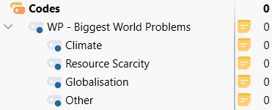
The Interview Guide – From Categories to (Sub-)Codes

Slide 37
One Approach: Thematic Coding (cf. Hopf et al 1995):
Creating a coding guide
Nr. | Category | Definition | Manifestations | Examples | Coding rules
1 | Biggest world problem | This category is used when current world problems are named, explained, or related to each other. Included are the respondents’ own positions and evaluations of the world problems. | Climate Resource scarcity War Globalisation Other | … | All climate related stuff (CO2, Sea level rise etc.) falls under „Climate“ …
Deductive: from literature review
Inductive: from interviews & materials

Slide 38
Tipps for Evaluating your Category System (cf. Rädiker & Kuckartz, 2020:47pp.)
Relation to research questions: categories are the key analytical tool for answering the research questions
Exhaustiveness: all relevant text passages can be assigned to a category; gaps indicate the system is incomplete (interim solution: add an "other" category)
Selectivity / distinctiveness: categories are clearly distinguishable from each other; it is always clear whether a statement belongs to a category or not (multiple coding of one passage is still possible)
Precise wording: category names accurately reflect what they are meant to capture (as precise as possible - e.g. "motives" vs. "attitudes")

Slide 39
Tipps for Evaluating your Category System (cf. Rädiker & Kuckartz, 2020:47pp.)
Fitting subcategories: subcategories must genuinely be aspects of their parent category, not something categorially different
Configuration has a "gestalt“: the system is more than a loose list; it has a recognisable structure and internal coherence; abstraction levels of individual categories should be comparable
Comprehensibility for recipients: categories appear in reports and presentations; wording should be accessible to the target audience
👉 feedback from colleagues helps

Slide 40
Development of evaluation categories – the Checklist:
Develop categories with reference to the interview guide and the exploration of your data
Add categories that are related to theory or relevant to the research question but do not appear in the guide
Set up the categories in MAXQDA’s “Code System” window
Add general categories to the category system: “other”, “flowers by the wayside” and “quotable text passages”
Record the (preliminary) category definitions in code memos

Slide 41
One Approach: Thematic Coding (cf. Hopf et al 1995):
✅ Development of evaluation categories
Coding the material
Quant. material overview
Optional: In-depth interpretation of individual cases

Slide 42
2. Coding the Material
Using the coding guide: Mark passages with explicit or implicit statements about categories of interest (= code them)

Slide 43
2.1 Basic Coding
Read through all the text
Rethink / define suitable coding rules for the analysis
Code the data by using the category system from step 2
Only assign text to categories
Perform a second round of coding for complex/difficult interviews
non-matches 👉 improve coding instructions & category definitions
Refine the category definitions in the code memos and add examples from the data
Add categories to the category system for new aspects 👉 no category without research question

Slide 44
2.2 Fine Coding (1/2)
Select & prioritise categories: not all basic categories need fine coding 👉 start with those most relevant to the research question
Compile coded segments: gather all segments assigned to the selected category in one view to get an overview of content and complexity
(Optional) Write key points per segment: briefly summarise the most important content of each coded segment in comments

Slide 45
2.2 Fine Coding (2/2)
Develop data-driven (= inductive) subcategories: read segments one by one, note emerging aspects, create new subcategories, merge similar ones, until no new aspects appear ( = saturation)
Define coding rules & write (sub-)category definitions: specify scope of coded segments and how to handle repeated statements; record definitions in code memos including inclusion/exclusion criteria
Apply subcategories to the data: code all remaining segments with newly created subcategories

Slide 46
One Approach: Thematic Coding (cf. Hopf et al 1995):
✅ Development of evaluation categories
✅ Coding the material
Quant. material overview
Optional: In-depth interpretation of individual cases

Slide 47
3. Quantitative Material Overview / Mappings:
→ usually only useful for multiple interviews
Overview of respondents and their characteristic constellations
👉 Inspiration for Interpretation & theory formation

Slide 48
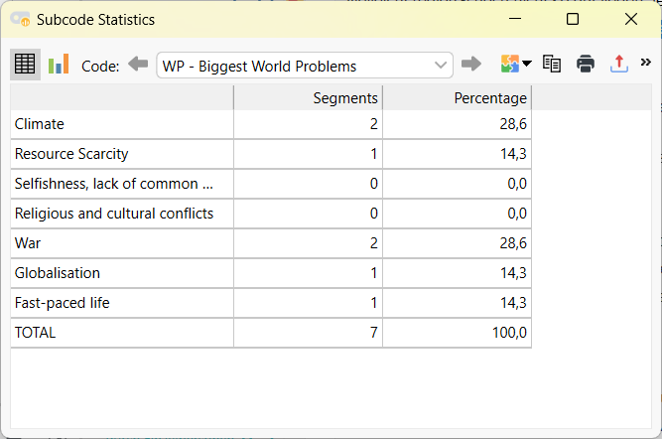
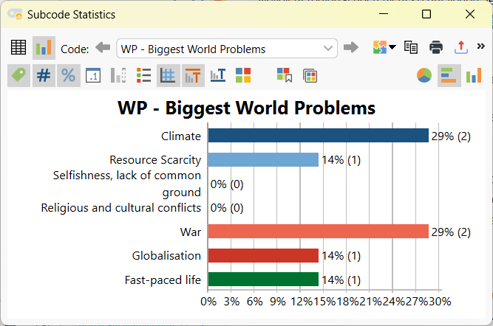
3.1 Code Frequencies: Code Statistics

Slide 49
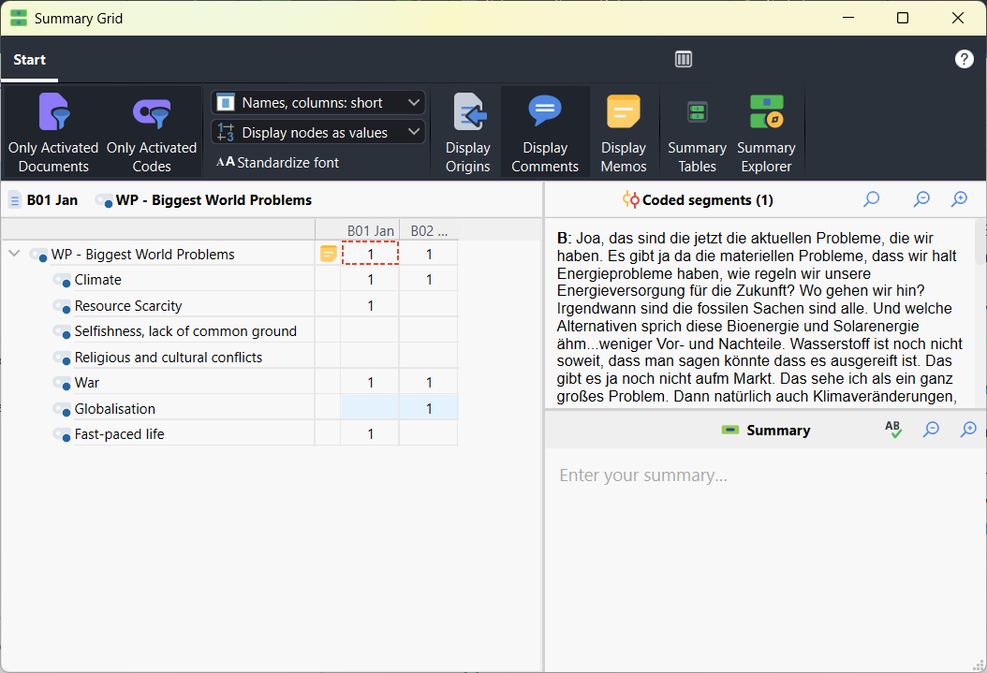
3.2 Code Frequencies across Cases: Summary Grid

Slide 50
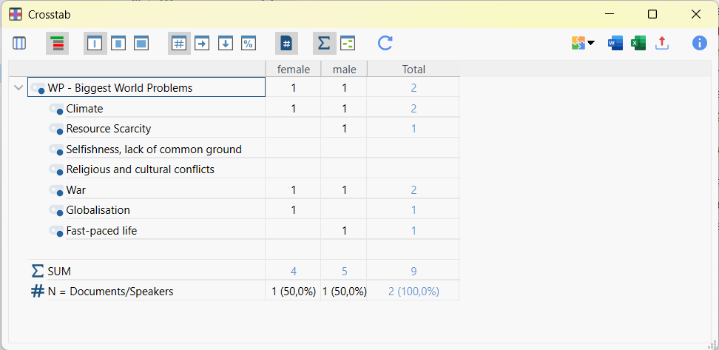
3.3 Code Frequencies across Document Variables: Crosstabs

Slide 51
3.4 Concept Mappings

Slide 52
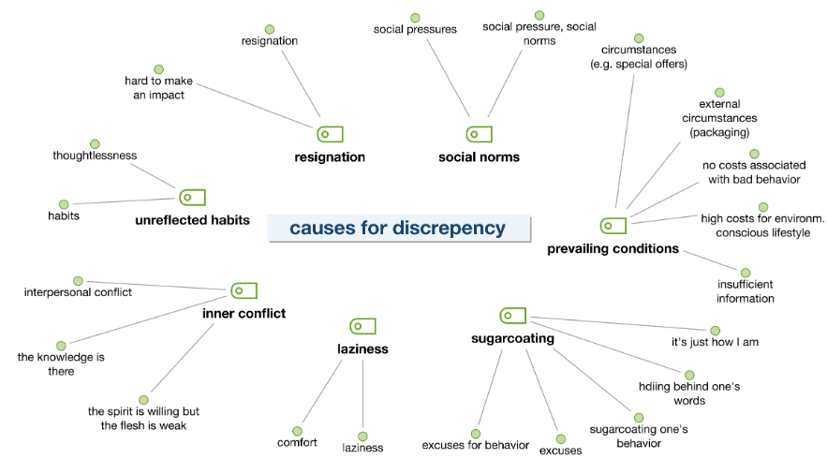
3.4 Concept Mappings

Slide 53
One Approach: Thematic Coding (cf. Hopf et al 1995):
✅ Development of evaluation categories
✅ Coding the material
✅ Quant. material overview
Optional: In-depth interpretation of individual cases

Slide 54
Some General Recommendations

Slide 55
Some general Recommendations from Rädiker & Kuckartz (2020:110)
Create an analysis plan including a time schedule taking into account the available resources
Analyse the key categories in more detail
Highlight important quotes from the interviewees for the research report 👉 “Quotes”-Code
Reflect on integrating a case-oriented perspective (how? in what way?) and, if suitable, include it in your analysis

Slide 56
Some general Recommendations from Rädiker & Kuckartz (2020:110)
Optional Elements:
Compare selected interviews with each other
Compare groups which have been created on the basis of sociodemographic and background variables 👉 Document Variables
Include linguistic aspects in the analysis:
metaphors, certain words, and phrases, etc.
Use visualizations, which are suitable for the presentation of the findings
Create concept maps

Slide 57

Train Transforming Questions into Categories and Sub-Codes
How to Analyze Qualitative Data in MAXQDA: Complete Tutorial

Slide 58
Can’t this AI Thing do this for Me?

Slide 59
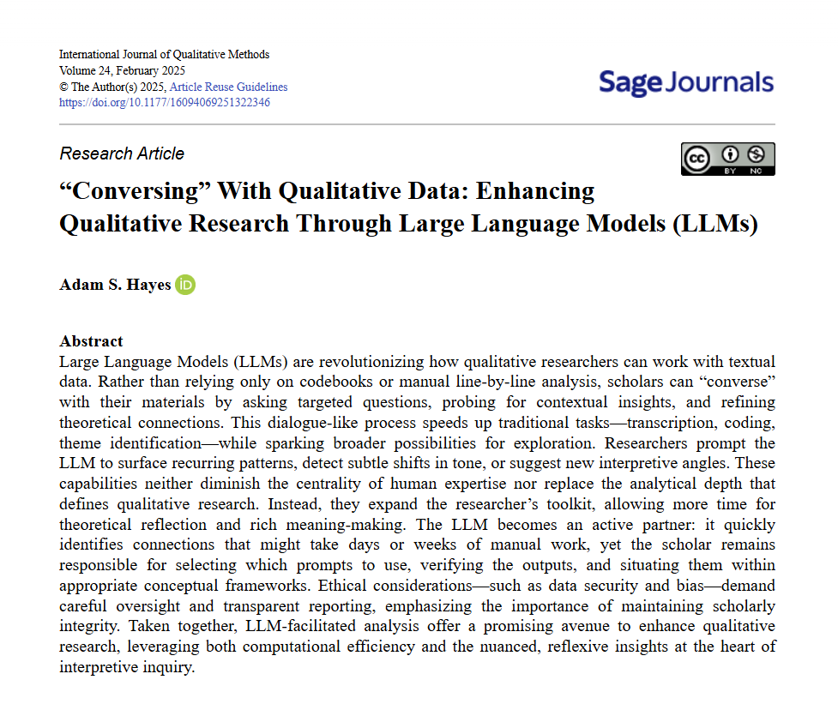
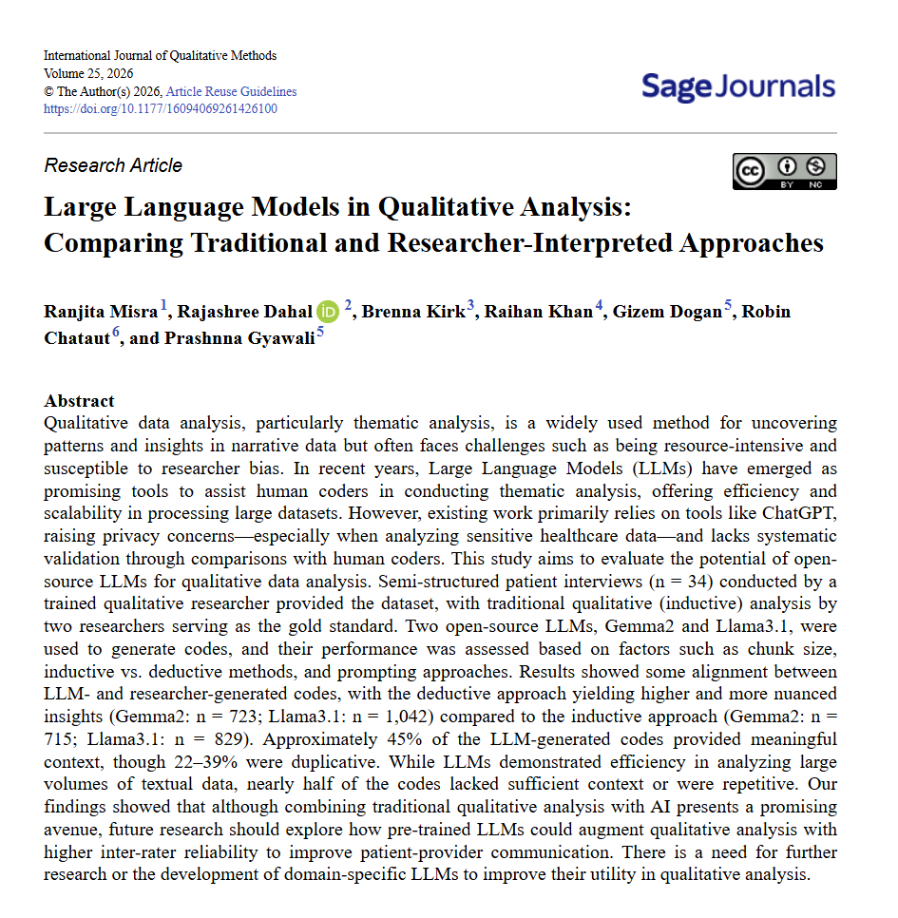

Yes, to a Degree

Slide 60
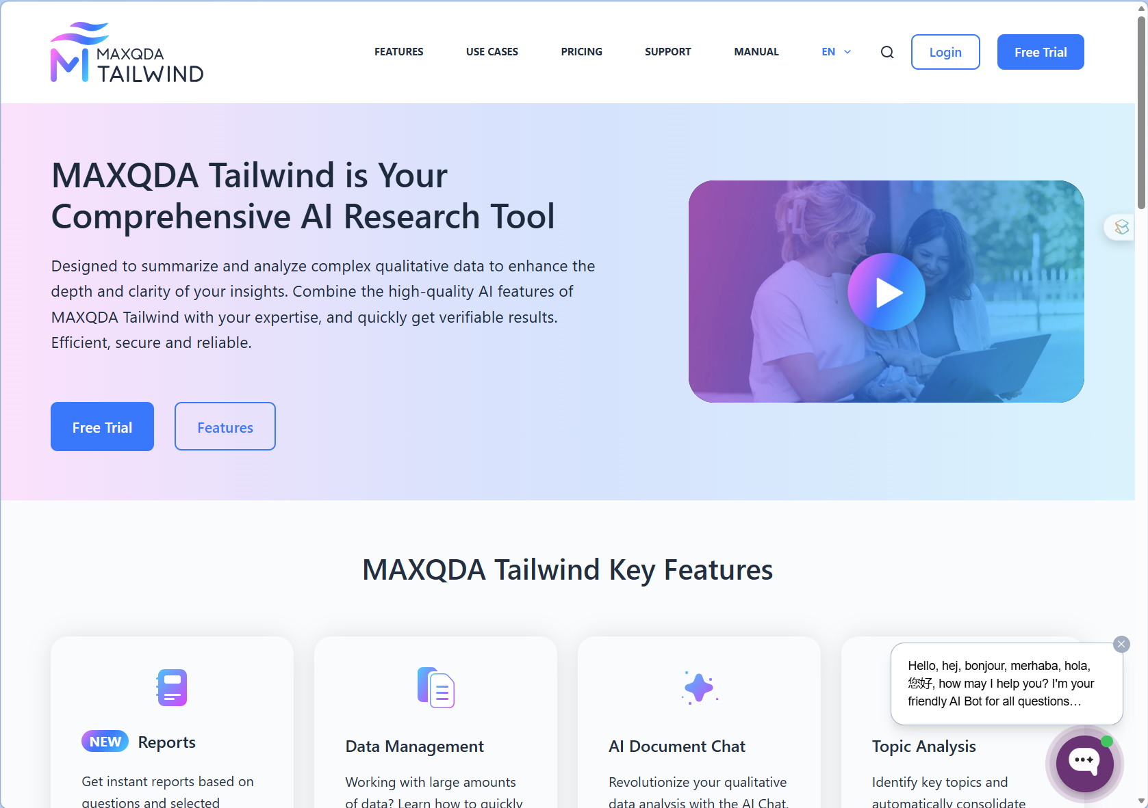
Yes, to a Degree

Slide 61
Always Remember: Quality Criteria in Science
Quality Criteria
Objectivity
Honesty
Verifiability
Reliability
Validity
Comprehen-sibility
Relevance
Logical Argumen-tation
Originality
Reproduci-bility

Slide 62
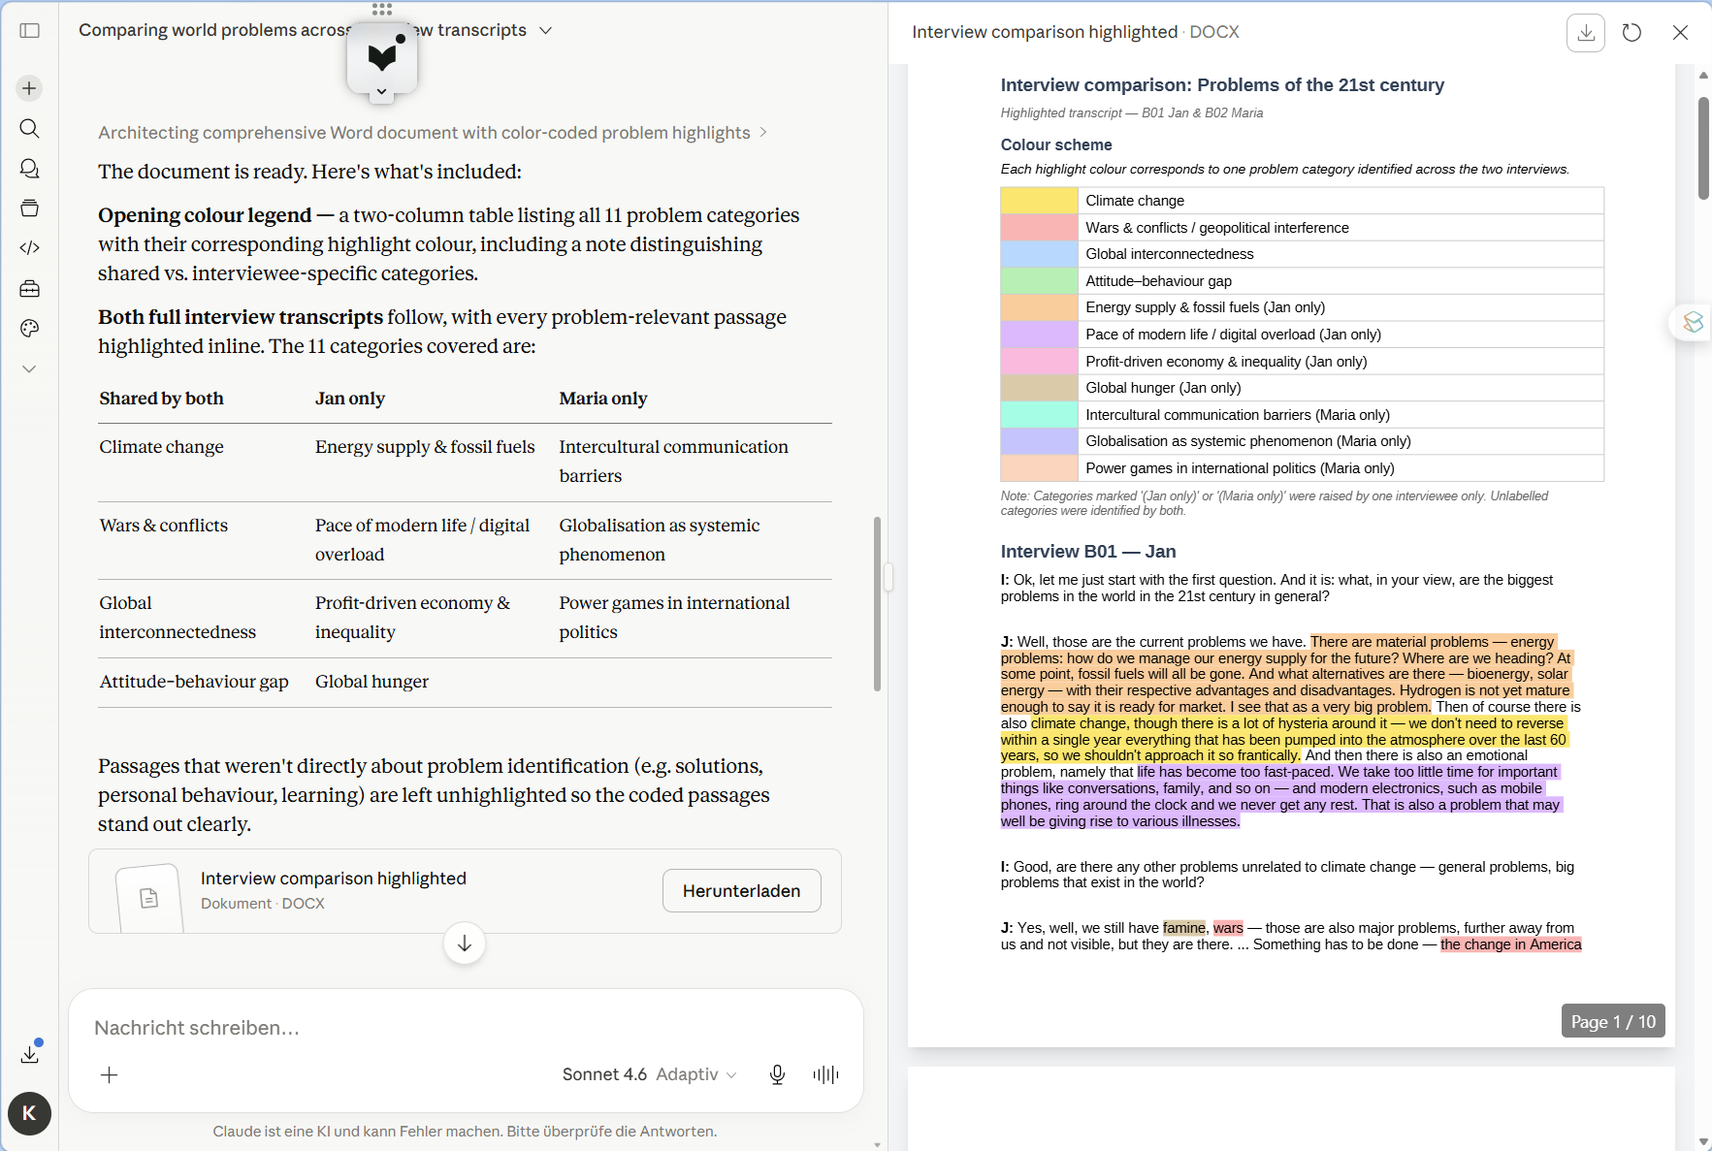
High-end or Budget-friendly?

Slide 63
High-end or Budget-friendly?
Possible prompts for our “Biggest World Problems”:
i have these two interview transcripts: both interviewees have been asked what are the biggest problems in the world in the 21st century. can you tell me which problems were identified by the two interviewees and give me a tabular comparison of communalities and differences between them
can you highlight the text passages according to each identified problem in a word document. pleas include a colour scheme explaining which problem is assigned to which color

Slide 65
Alles Selber machen lassen?
“With generative AI, we have not only gained a very powerful tool, but also an assistant for the entire research process. It aids in verifying category development, differentiating categories, and coding data. Many students have wondered how to implement qualitative content analysis – requiring intersubjective validity – into their dissertations, bachelor’s, and master’s theses. Since they often work alone, they lack opportunities to compare their categories and coding with others. Generative AI now makes it possible to compare one’s own categories and subcategories with those of the AI. The codings can also be compared with those of the AI” (Kuckartz & Rädiker, 2024:15)

Slide 66
Alles Selber machen lassen?
AI = Assistant =
Transferring research questions into categories
Researching theory-guided Sub-Categories
Basic & Fine-Coding:
Get ideas for sub-codes
Get inspirations for relations between categories
…
👉 You make the final decisions in your analysis 👉 Document how you used your AI-assistant(s)

Slide 67
Conclusions

Slide 68
Conclusions
Data ≠ numbers only: text, images, audio, video & networks
Qualitative interviews: access to subjective views & meanings
open questions, interaction & interpretation
Interview workflow: preparation → conducting → transcription → content analysis
Qualitative content analysis: coding & categorising texts, images & media
deductive & inductive category development
LLMs = research assistant for verifying categories, sub-codes, codings etc.

Slide 69


So long & cheerio!

